Slide 1
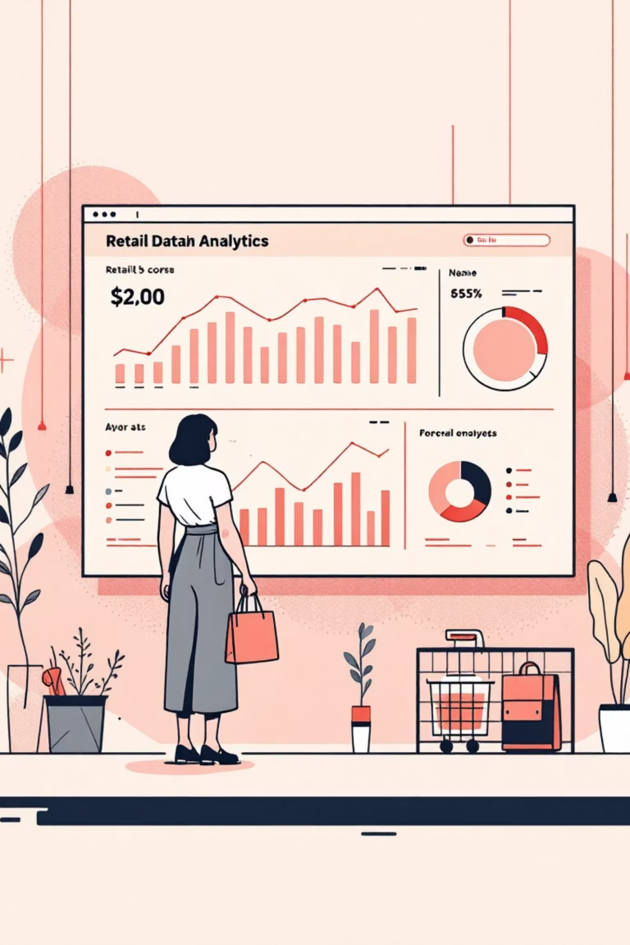
Customer Shopping Behavior Analysis
Uncovering insights from 3,900 purchases to guide strategic business decisions

Slide 2

OVERVIEW
Dataset at a Glance
3,900
18
$59.76
Total Purchases
Data Points
Avg Purchase
Transactions analyzed across all categories
Features tracked per customer
Mean transaction value
3.75
Avg Rating
Customer satisfaction score

Slide 3

DATA PREPARATION
Python Analysis Pipeline
01
02
Data Loading & Exploration
Missing Data Handling
Imported dataset, checked structure with pandas
Imputed 37 missing review ratings using category medians
03
04
Feature Engineering
Database Integration
Created age groups and purchase frequency columns
Loaded cleaned data into PostgreSQL for SQL analysis

Slide 4
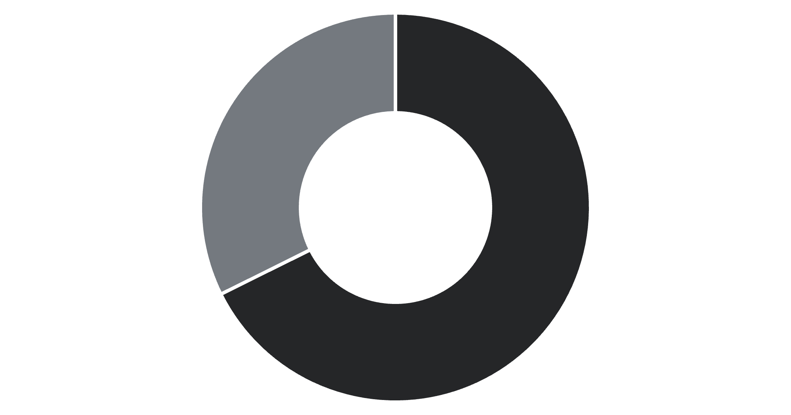
REVENUE INSIGHTS
Gender Revenue Comparison
Male customers drive 68% of total revenue
Despite representing 68% of customers, male shoppers generate significantly higher revenue concentration
Male
Female

Slide 5
Top-Rated Products
3.86
3.84
3.82
Gloves
Sandals
Boots
3.80
3.78
Hat
Skirt
Highest average review ratings across all product categories

Slide 6


SHIPPING
Shipping Type Impact
Express
Standard
$60.48
$58.46
Average purchase
Average purchase
Express shipping customers spend 3.5% more on average

Slide 7



Customer Segmentation
New
1
83 customers
Returning
2
701 customers
Loyal
3
3,116 customers
80% of customers are loyal with multiple purchases, indicating strong retention

Slide 8


SUBSCRIPTION ANALYSIS
Subscribers vs Non-Subscribers
27%
73%
Subscribers
Non-Subscribers
1,053 customers
2,847 customers
Average Spend
Repeat Buyers (>5 purchases)
Subscribers: $59.49
Subscribers: 958
Non-subscribers: $59.87
Non-subscribers: 2,518

Slide 9
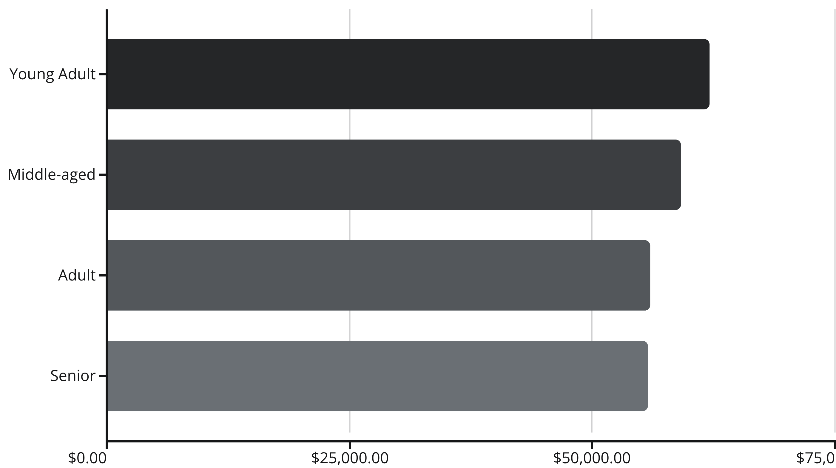
Revenue by Age Group
Young adults lead revenue generation, followed closely by middle-aged customers

Slide 10
STRATEGY
Business Recommendations
Boost Subscriptions
Loyalty Programs
Review Discount Policy
Promote exclusive benefits to convert the 73% non-subscriber base
Reward repeat buyers to strengthen the 80% loyal customer segment
839 high-spending discount users show opportunity to optimize margins
Product Positioning
Targeted Marketing
Highlight top-rated items like Gloves and Sandals in marketing campaigns
Focus on young adults and express-shipping users for maximum ROI

